Slide 1


Presentation on Historica AR/VR Powered Immersive Historical Learning Experience
Guided By: Presented By:
Prof. Monika Choudhary Atharv Sharma (0827IT233D02)
Khushi Agrawal (0827IT221076)
Abhishek Rathore (0827IT233D01)
Jatin Rao (0827IT233D03)

Slide 2
Contents
Introduction
1.1 Overview
1.2 Purpose
Requirement Engineering
2.1 Requirement Collection
2.2 Functional Requirements
2.3 Non Functional Requirements
2.4 Use Case Diagram
Technical Design
3.1 Technical Architecture
3.2 Sequence Diagram
3.3 Class Diagram
3.4 DFD
User Interface Design
Data Design
5.1 Schema Design
5.2 E-R Diagram
REFERENCES

Slide 3
1. Introduction
1.1 Overview
Historica is a web-based platform that provides interactive 3D models of historical sites, showcasing how they appeared in ancient times.
It allows users to explore ancient landmarks in detail with zoom, rotation, and AR integration for an immersive experience.
The platform combines historical accuracy with digital technology, making history more engaging and accessible.
Designed for students, researchers, educators, and history enthusiasts, it serves as an educational and cultural preservation tool.
1.2 Purpose
Enhance Historical Learning: Provides an interactive way to study history with visual reconstructions, making education more engaging.
Virtual Exploration & Tourism: Enables users to experience historical sites remotely, bridging the gap between travel and digital learning.

Slide 4
2. Requirement Engineering 2.1 Requirement Collection
User surveys & interviews: Talked to students and teachers to understand what features they’d like to see.
Studying similar apps: Analyzed platforms like Sketchfab and more to see what works well and what’s missing.
Continuous feedback: Created basic screen designs (UI flowcharts) and got early feedback from potential users.
Consultation with developers: Discussed with the tech team to ensure selected tools could support 3D/AR features.
Research on historical content needs: Referred to sources like UNSECO and CyArk to understand what kind of information and accuracy users expect.

Slide 5
2.2 Function Requirements (What the app must do)
Site selection on map: Users can view and select historical sites through an interactive map interface.
3D model interaction: Users can rotate, zoom, and explore the site’s 3D model in detail.
Time travel feature: A button allows switching between the site's current look and its state 100 years ago.
Information display: Each site shows historical facts, images, and timelines for learning purposes.

Slide 6
2.2 Non Functional Requirements (How the app should perform)
Fast and smooth performance: Built with Vite and optimized 3D rendering for fast load and smooth animations.
Cross-device compatibility: Works well on desktops, tablets, and phones, future-ready for VR headsets.
Easy to maintain & update: Uses TypeScript and Drizzle ORM to make backend logic and updates easy to manage.
Attractive and responsive UI: Uses Tailwind CSS, Framer Motion, and Lucide icons to create a user-friendly and visually appealing interface.

Slide 7
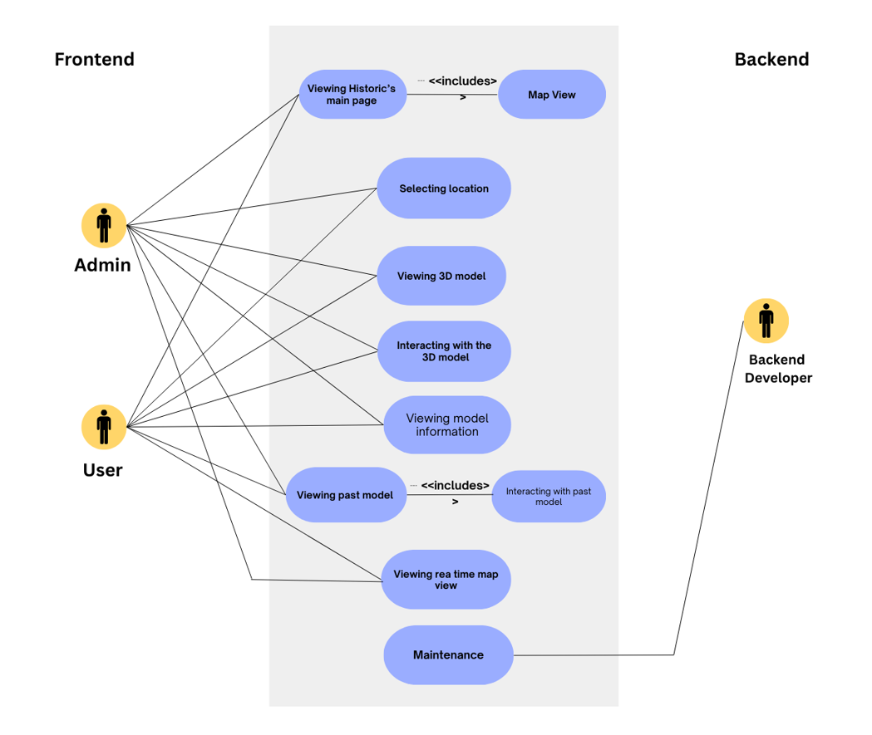
2.3 Use Case Diagram

Slide 8
3. Technical Design 3.1 Technical Architecture
System Architecture Diagram

Slide 9
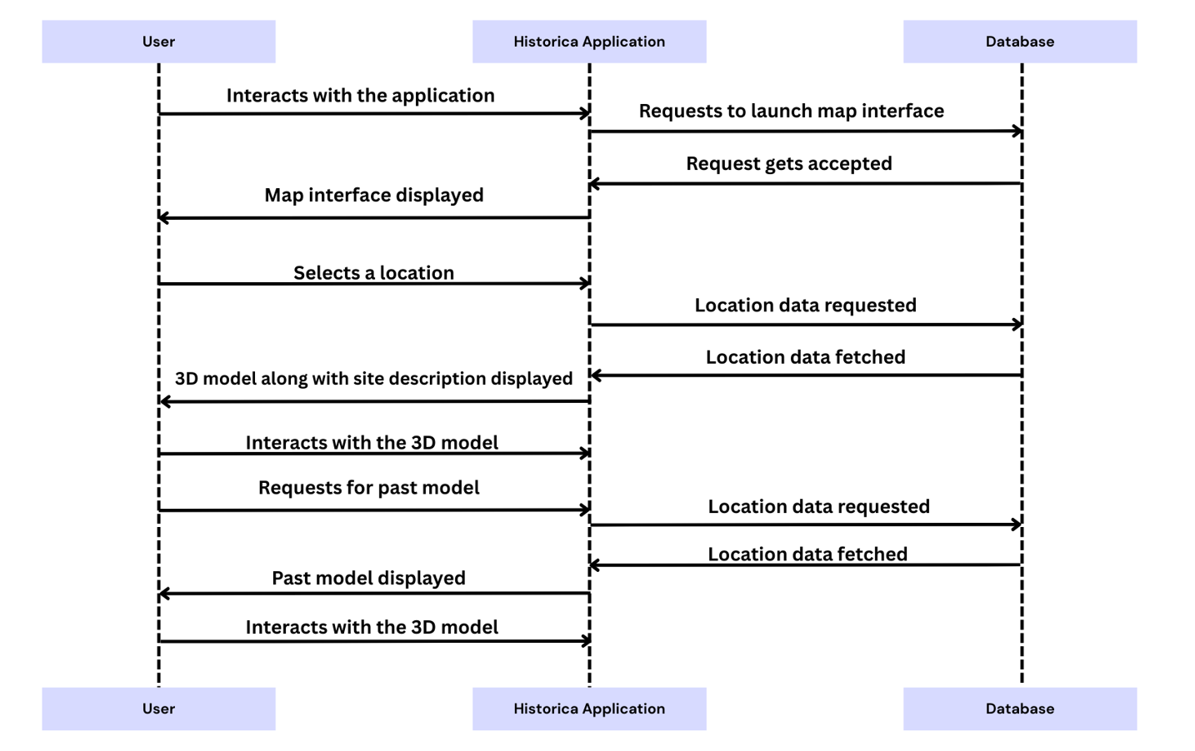
3.2 Sequence Diagram

Slide 10
3.3 Class Diagram
System Class Diagram

Slide 11
3.4 DFD
DFD Diagram

Slide 12
4. User Inface Design
(Note: Need to show the Working UI during the presentation and Attach Screen Shots of working UI here)

Slide 13
4. Data Design 4.1 Schema Definition
Complete Database Design.

Slide 14
4.2 E-R Diagram
System E-R Diagram

Slide 15
GitHub Link
https://github.com/Atharv-082004/Historica

Slide 16
REFERENCES
WebAR and 3D Visualization Technologies: Utilizes Three.js (threejs.org), A-Frame (aframe.io), and Model Viewer (modelviewer.dev) for rendering interactive 3D models and AR experiences in web browsers.
Archaeological & Historical Research Sources: Based on UNESCO’s cultural heritage data (whc.unesco.org), academic research papers, and museum archives to ensure accurate reconstructions of historical sites.
CyArk (www.cyark.org)

Slide 17
Thank You
Queries ?

